Slide 1
Lessons Learned from Working Remotely
St. Louis, 2015
Michael Eaton / @mjeaton

Slide 2
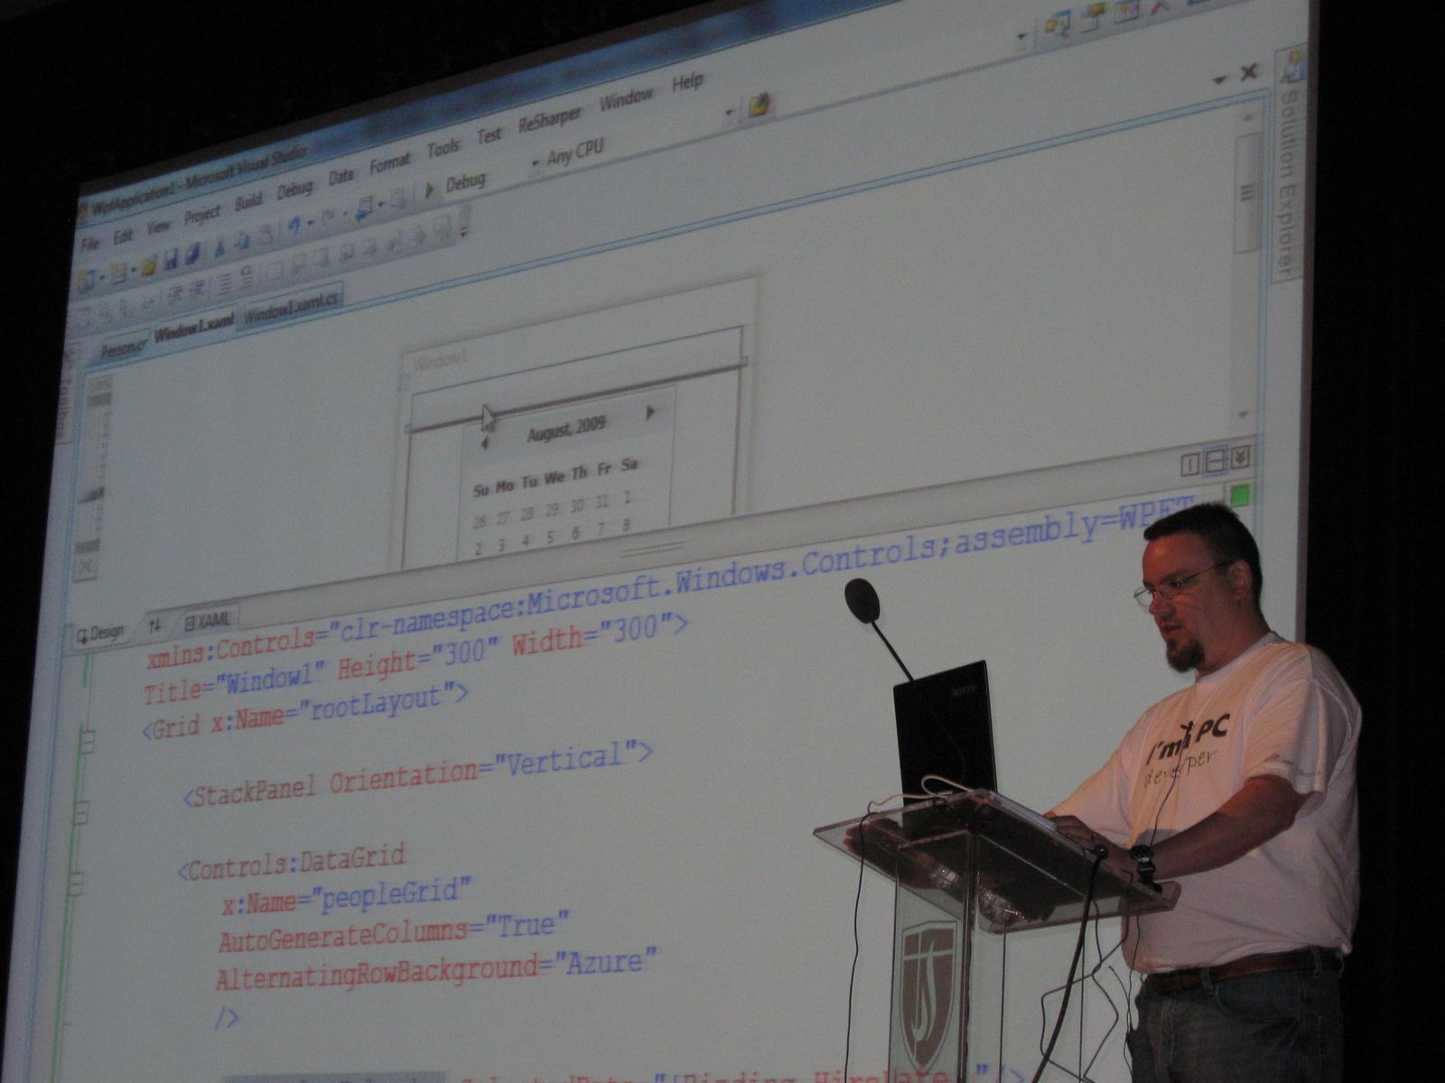
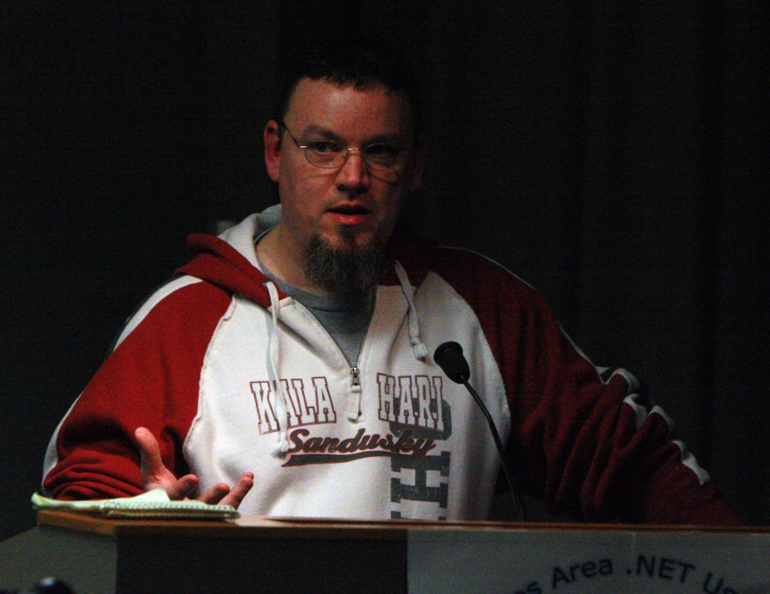
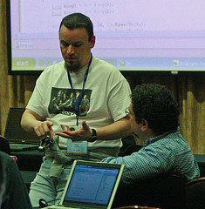
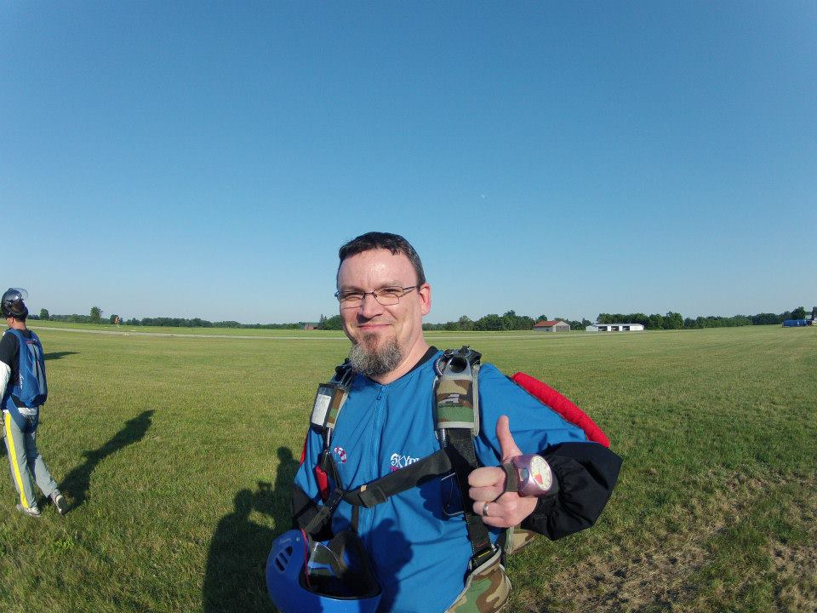
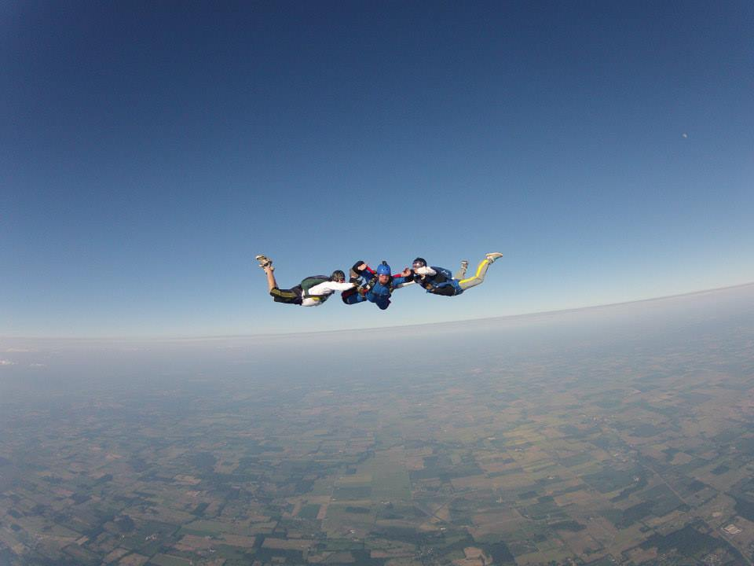

Slide 3

#1 Place to work in IT for the 3rd year in a row! http://bit.ly/quickenLoans1
We’re hiring! Interested? Let me know! @mjeaton / mikeeaton@quickenloans.com

Slide 4
about.me/mjeaton
Notes:
About.me/mjeaton

Slide 5

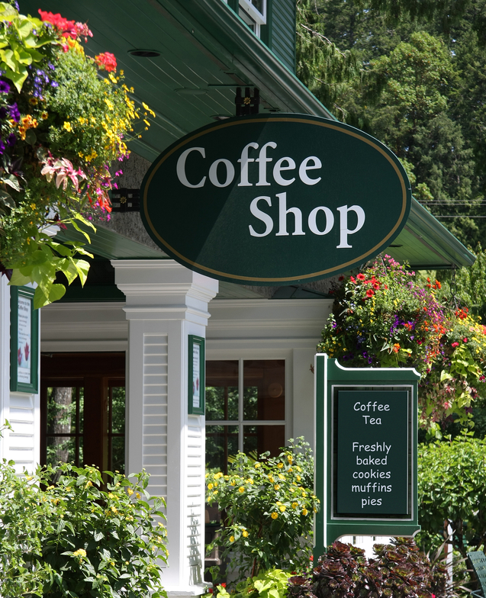
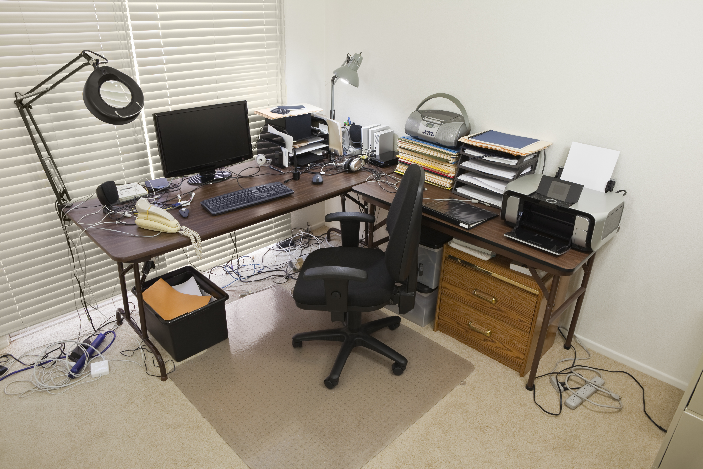
what is remote working?

Slide 6


what is remote working?

Slide 7
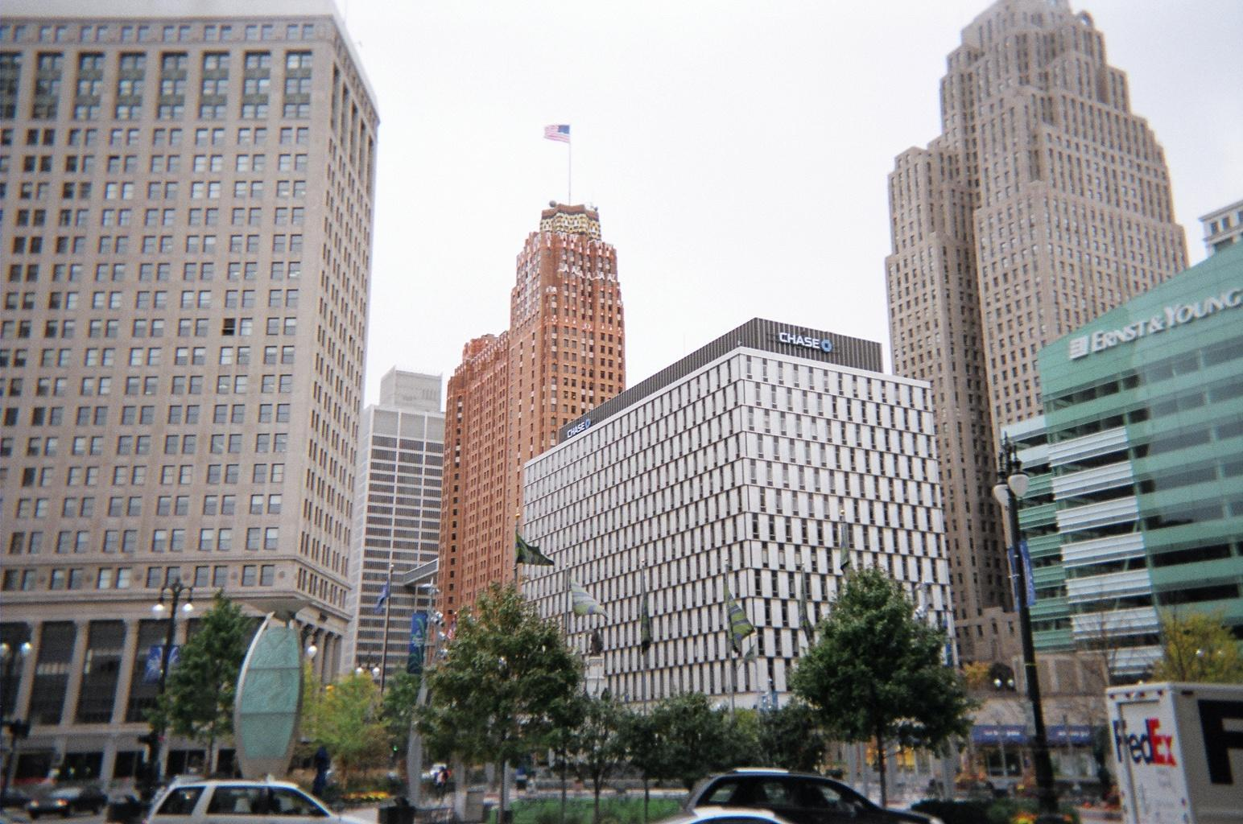
what is remote working?

Slide 8
my remote working history
1994 to 1995 – Worked remotely on a team of 6 or 7. Worked in a silo.

Slide 9
my remote working history
1996 – Sole developer for small, custom dev shop.

Slide 10
my remote working history
1997 to 2000 – Worked on a team of 5. Best team EVER.

Slide 11
my remote working history
2000 to 2001 – Project Director/Team Lead for mid-size consulting firm. Led several project teams.

Slide 12
my remote working history
2001 to early 2006 – Independent consultant – worked mostly alone, but did contribute to a couple project teams during that time.

Slide 13
my remote working history
2006 (roughly 9 months) – Tried my hand at working for “The Man” again. Worked on a small dev team.

Slide 14
my remote working history
2006 to 2014 – Independent consultant. Variety of projects.

Slide 15
my remote working history
November 2014 to Now – Remote team member at Quicken Loans.

Slide 16
remote working
pros
cons
No commute
More time with family/friends
Flexible schedule
More ability to focus
Customized workspace
Miss out on interactions
Self promotion is tougher

Slide 17

convincing your boss

Slide 18

convincing your boss

Slide 19

convincing your boss

Slide 20
tips for remote working
Be present / available
Be disciplined
Have a dedicated space
Use technology to your advantage

Slide 21
tips for remote working
Take advantage of the flexibility

Slide 22
questions?

Slide 23
contact
http://about.me/mjeaton

Slide 24
Image credits
The Chase Building, downtown Detroit – https://commons.wikimedia.org/wiki/File:ChaseBuildingDetroit.JPG

